Slide 1

Movie Sales Analysis
Presented By
A. Sagar
V. Yashwanth
435 Batch

Slide 2
Agenda :
Business Problem
Objective
Summary of the Data
Data Preparing
Data Visualizations
Key Insights
Conclusion

Slide 3
Business Problem Statement:
The movie industry produces many films every year with different genres and budgets. However, not all movies perform well at the box office. Production houses struggle to understand which factors drive higher revenue. There is uncertainty about the impact of ratings, runtime, and genre on movie success. Audience preferences and genre popularity also change over time. This project analyzes movie sales data to support better, data-driven business decisions

Slide 4
Objective:
To analyze movie sales data and understand box office revenue trends over time.
To identify top-performing genres, movies, and directors based on revenue.
To study the relationship between IMDb ratings, votes, runtime, and revenue.
To understand audience preferences and genre popularity changes over the years.
To identify the optimal movie runtime for better ratings and revenue.
To create an interactive Power BI dashboard for data-driven decision-making.

Slide 5

Dataset Overview :
The dataset contains information about movies released across multiple years with the following key attributes:
  Movie Details: Title, Genre, Director, Actors
  Time Attributes: Year of release
  Performance Metrics: Revenue (Millions), Votes
  Quality Metrics: IMDb Rating, Meta score
  Technical Details: Runtime (Minutes)

Slide 6
Data Preparing
Imported CSV files into Power BI​
Removed duplicate records
​Handled null and missing values
​Standardized column names ​and Converted data types
​Created DAX measures:
​Total Revenue​
Average Rating​
Total Votes​
Movie Count

Slide 7
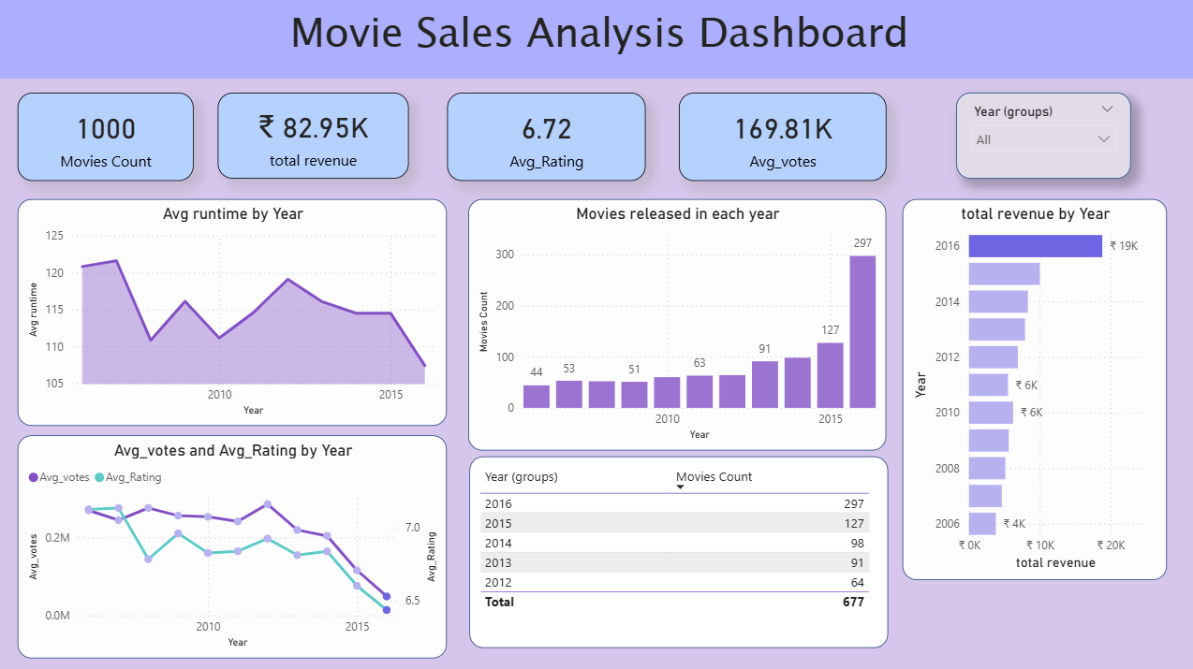

Slide 8
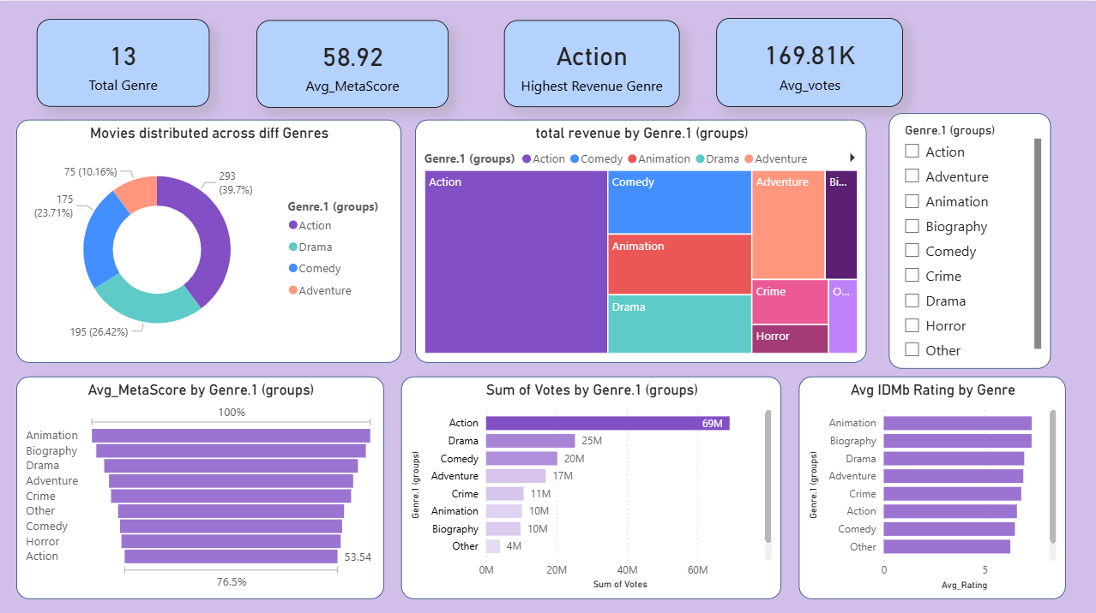

Slide 9
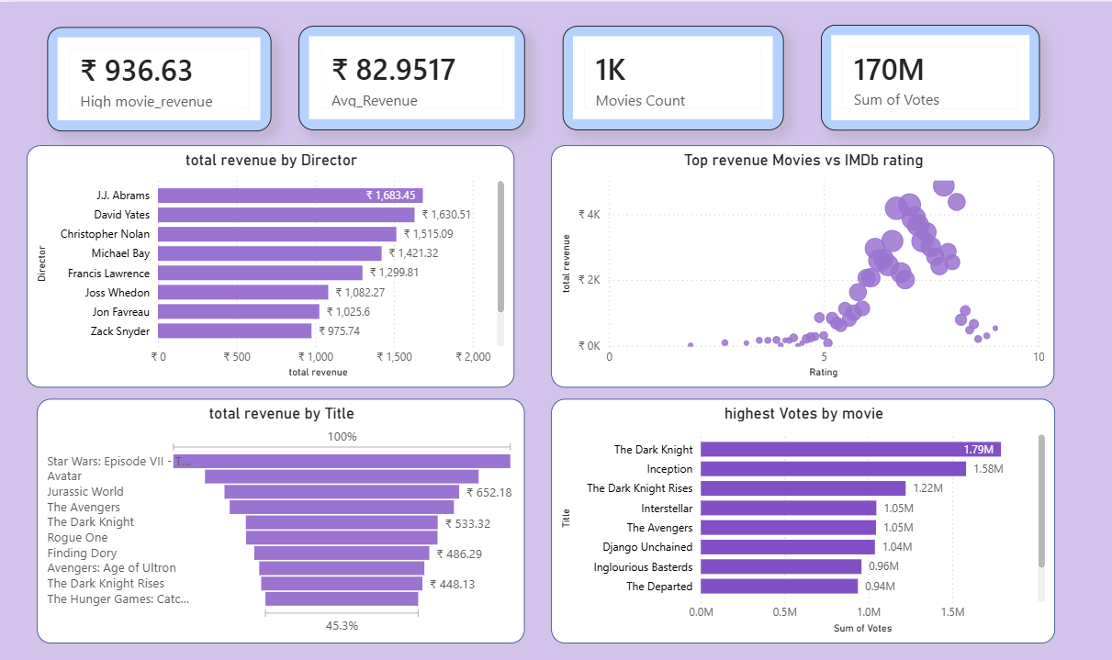

Slide 10
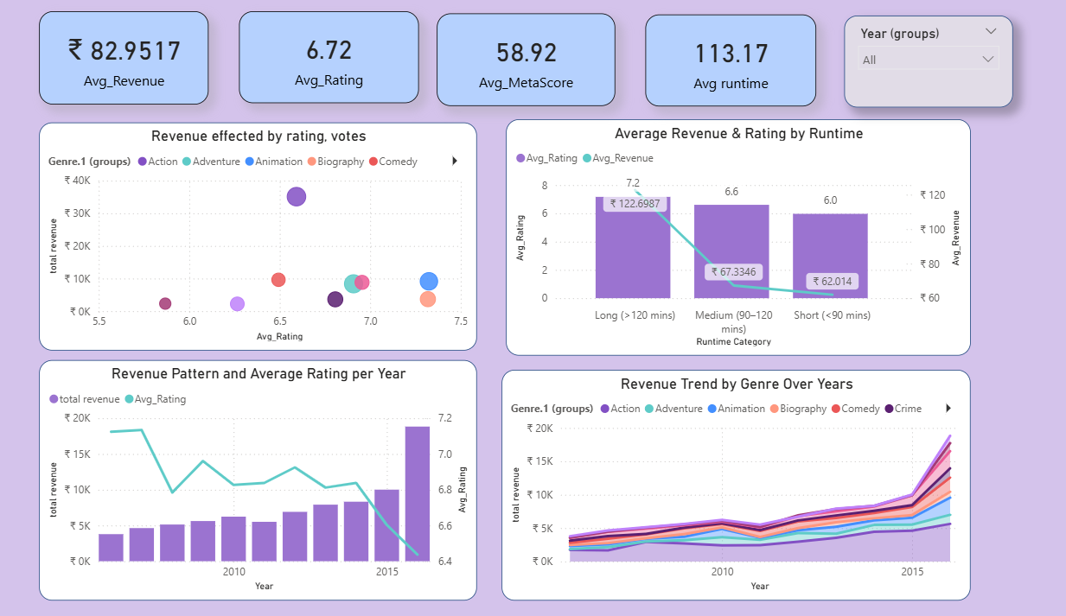

Slide 11
Main Key Insights :
Action is the highest revenue-generating genre, contributing the largest share to total box office revenue.
Movie releases and total revenue have increased over the years, showing growth in the movie industry.
Medium-length movies (90–120 minutes) perform best, earning higher average revenue and good audience ratings.
Higher IMDb ratings generally support higher revenue, but ratings alone do not guarantee box office success.
Movies with higher audience votes earn more revenue, highlighting the strong impact of popularity.
A small number of top movies and directors contribute a major share of total revenue, showing revenue concentration.

Slide 12
Conclusion :
This project analyzed movie sales data to understand trends in revenue, ratings, genres, and audience engagement.
The analysis shows that revenue is influenced by multiple factors such as genre, ratings, votes, and runtime.
Medium-length movies and popular genres tend to perform better at the box office. Higher IMDb ratings generally support better revenue, but they are not the only success factor.
A small number of top movies and directors contribute significantly to overall revenue.
Overall, the dashboard provides valuable insights to support data-driven decisions in the movie industry.

Slide 13
THANK YOU

